Slide 1
IBM AICTE PROJECT Travel Planner Agent
Presented By:SUGHASHINI T
Student name : SUGHASHINI T
College Name & Department:UNIVERSITY COLLEGE OF ENGINEERING,VILLUPURAM&COMPUTER SCIENCE AND ENGINEERING.

Slide 2
OUTLINE
Problem Statement
Technology used
Wow factor
End users
Result
Conclusion
Git-hub Link
Future scope
IBM Certifications

Slide 3
Problem Statement
Travel planning can be a time-consuming and overwhelming process for individuals and groups, involving extensive research across various websites for flights, accommodations, activities, and local information. Travelers often struggle to find personalized recommendations, compare complex itineraries, and manage last-minute changes efficiently. The current landscape is fragmented, leading to decision fatigue and missed opportunities for optimal travel experiences.

Slide 4
Technology used
IBM Cloud Lite services
Natural Language Processing (NLP)
Retrieval Augmented Generation (RAG)
IBM Granite model
Recommendation Engines
Predictive Analytics

Slide 5
IBM cloud services used
IBM Cloud Watson AI Studio
IBM Cloud Watson AI runtime
IBM Cloud Agent Lab
IBM Cloud Functions (for real-time updates and notifications)
IBM Cloud Object Storage

Slide 6
Wow factors
Reduce Travel Planning Time: By automating research and itinerary generation.
Enhance Personalization: Provide highly relevant recommendations based on user preferences and past travel.
Streamline Booking Process: Integrate with booking platforms for seamless reservations.
Provide Real-Time Support: Offer immediate assistance for changes, cancellations, or in-travel queries.
Discover Unique Experiences: Suggest off-the-beaten-path activities and local insights.
Optimize Cost and Value: Identify the best deals for flights, hotels, and packages.
Semantic Search across Travel Data: Efficiently search through vast amounts of travel information (reviews, guides, availability).
Auto-summarization of Travel Options: Quickly provide key details about destinations, accommodations, and activities.

Slide 7
End users
Individual Travelers
Families & Groups
Business Travelers
Travel Agencies/Consultants
Event Organizers.

Slide 8
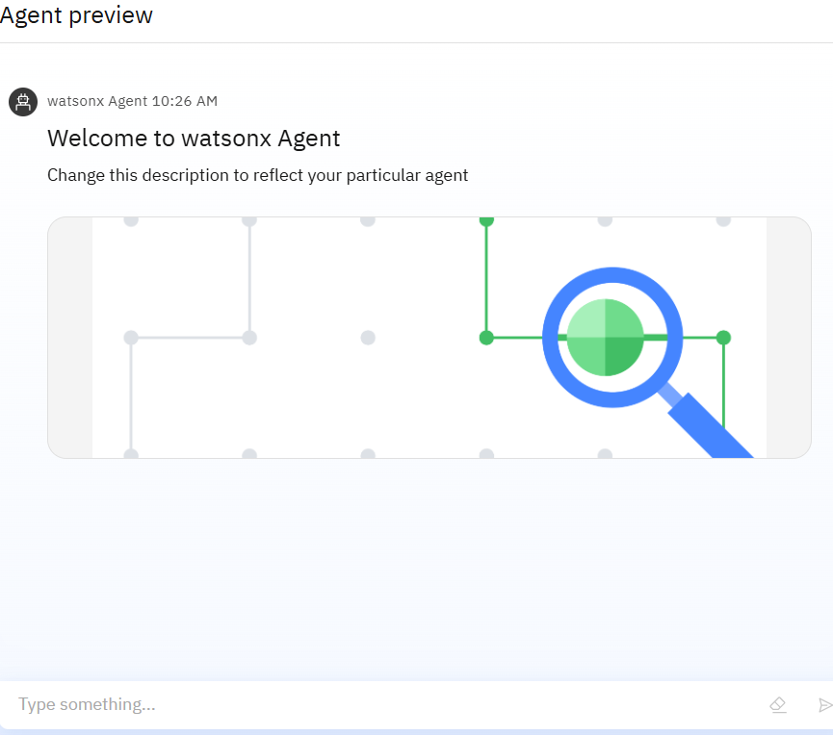
Results
Personalized Itineraries: Generates a custom, day-by-day travel plan including flights, hotels, and activities based on user preferences, budget, and real-time data.
Seamless Booking & Management: Integrates with booking platforms to find the best deals, handle reservations, and manage changes or cancellations with simple user commands.
Real-Time Assistance: Provides instant, on-the-go support with up-to-date information on weather, local guides, and last-minute schedule optimizations to ensure a smooth travel experience.

Slide 9
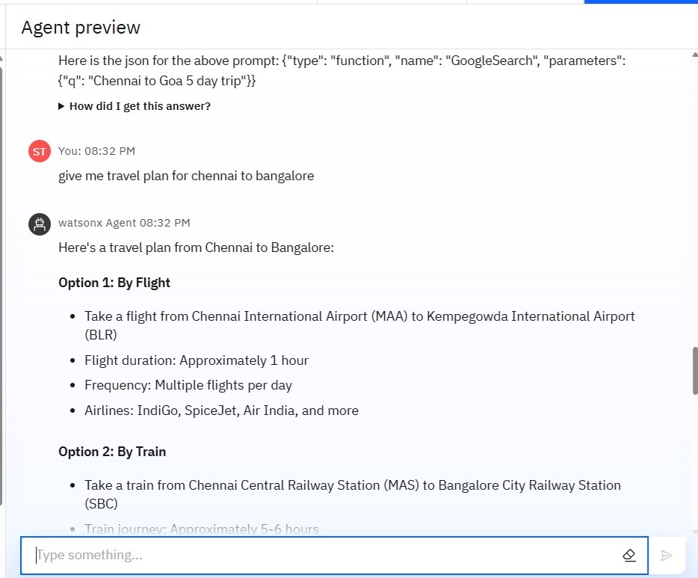
Results
Intelligent Itinerary Generation: The AI agent analyzes user preferences, budget, and real-time data to automatically create a personalized and comprehensive travel plan, including flight, accommodation, and activity suggestions, thereby transforming complex planning into a single, seamless process.

Slide 10
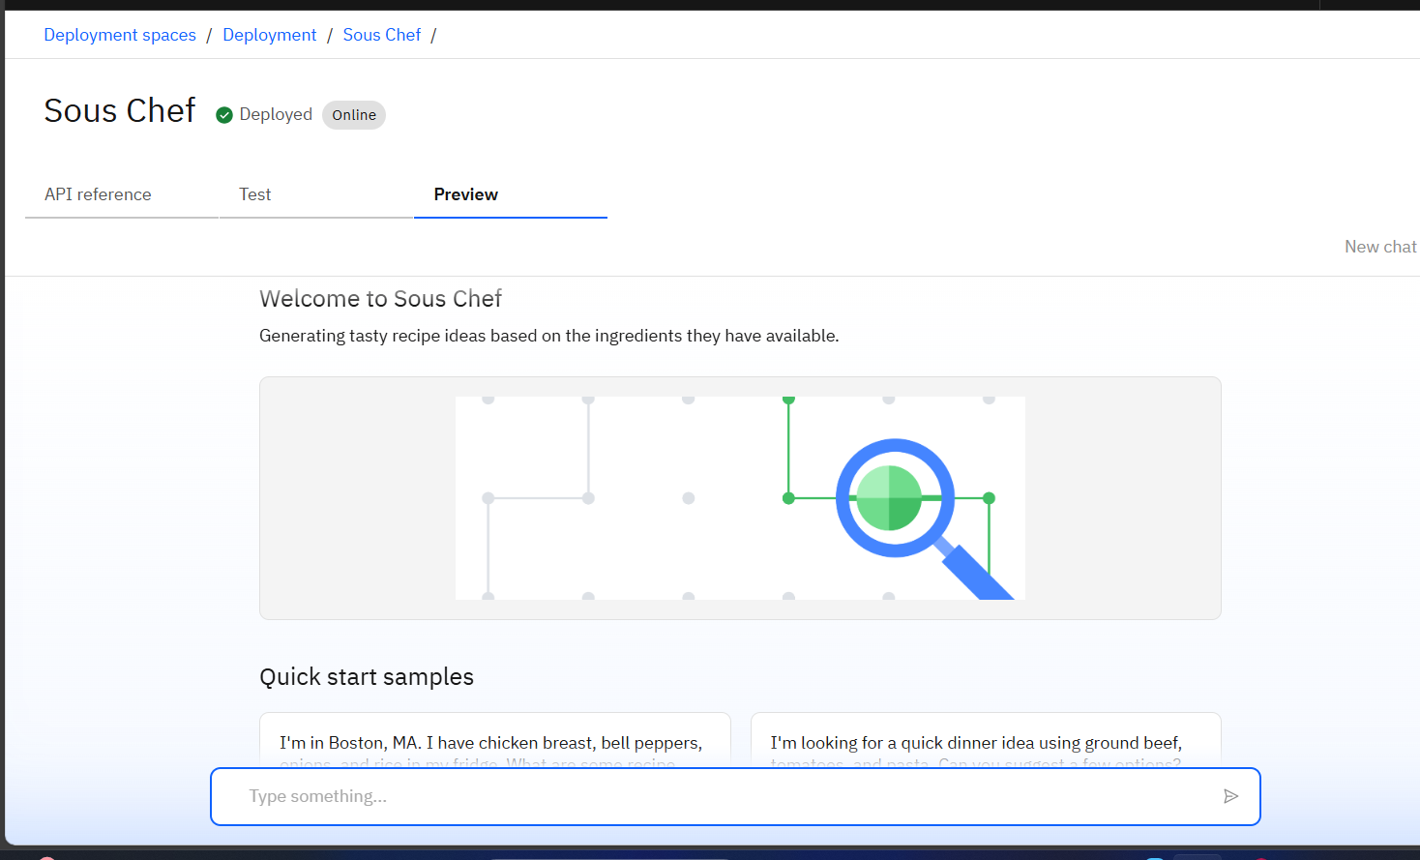
Results

Slide 11
Conclusion
The AI Travel Agent can significantly streamline the travel planning process, generate personalized itineraries, suggest optimal travel options, and even assist with real-time changes and support. It saves time by automating repetitive tasks like destination research, price comparison, and booking management. This AI agent enhances efficiency, accuracy, and innovation in both individual travel planning and potentially for travel industry professionals, leading to more enjoyable and stress-free travel experiences.

Slide 12
GitHub Link
https://github.com/SGHASHINIT/travel_agent

Slide 13
Future scope
Voice interaction for accessibility.
Multilingual support.
Integration with national admission portals.
Chatbot UI for websites and mobile apps.
Data analytics dashboard for institutions.

Slide 14
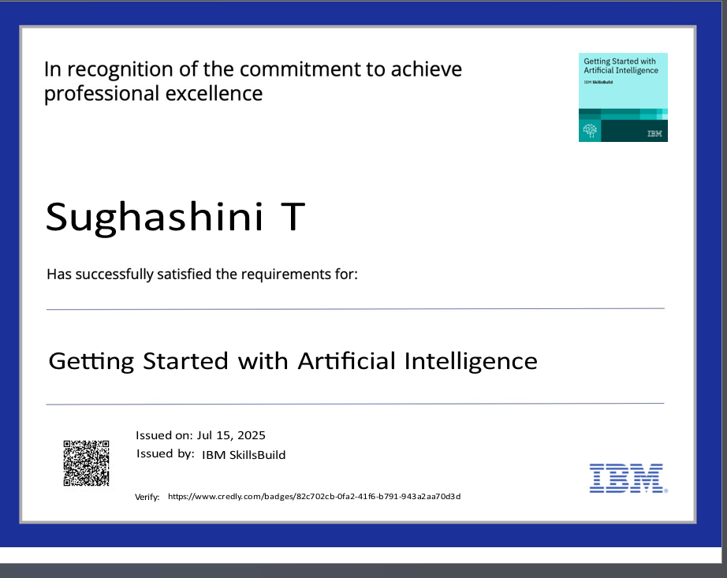
IBM Certifications

Slide 15
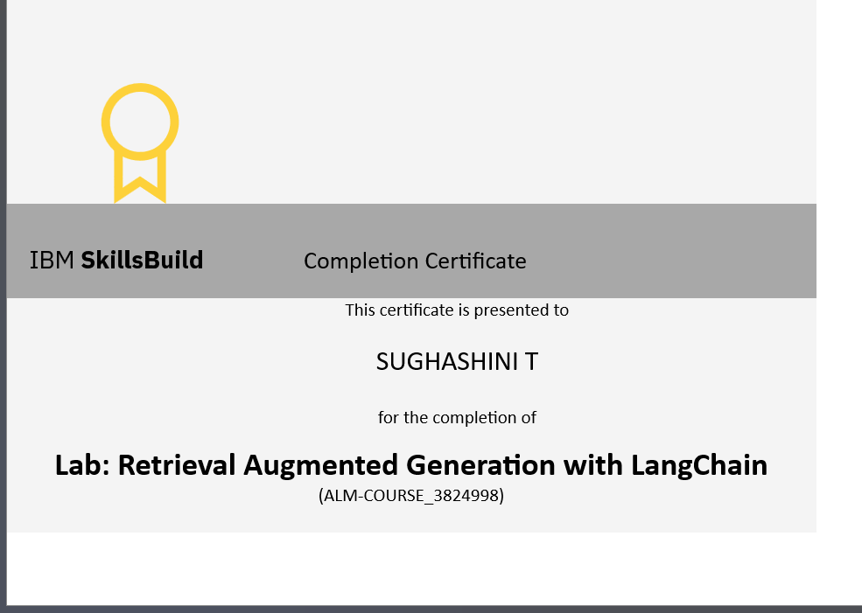
IBM Certifications

Slide 16
THANK YOU

